Slide 1

Rajiv Gandhi College of Engineering, Research and Technology
Department of Computer Science and Engineering
MEGA PROJECT SEMINAR ON :
BookAR: Augmented Reality Experience for Traditional Books
Presented By :
Gaurav Khadilkar
Pratik Khairwar
Chetankumar Meshram
Himanshu Sharma
Kaivalya Tannirwar
CSEB702 CSEB703 CSEB714 CSEB744 CSEA750
Guided By : Dr. Nitin Janwe
Project In-charge : Dr. Manisha Pise
Dr. Nitin Janwe
HOD , CSE Dept.

Slide 2
Rajiv Gandhi College of Engineering, Research & Technology, Chandrapur
Department of Computer Science & Engineering
Institute Vision
To be on forefront to impart quality education to address societal and industrial needs and imbibe career skills through perseverance and practice.
Institute Mission
M1. To adapt innovative student centric learning methods based on understanding and practice.
M2.To enhance professional and entrepreneurial skills.
M3.To motivate students to meet dynamic needs of the society with novelty and creativity.
M4.To promote research and continuing education to keep the country ahead.
M5.To promote the mindset to acquire local solutions to local problems (LS2LP). Department Vision To be a centre of excellence in Computer Science & Engineering by imparting knowledge, professional skills and human values.
Department Mission
M1. To create encouraging learning environment by adapting innovative student centric learning methods promoting quality education and research.
M2. To make students competent professionals and entrepreneurs by imparting career skills and ethics.
M3. To impart quality industry oriented education through industrial internships, industrial projects and partnering with industries to make students corporate ready.

Slide 3
Programme Educational Objectives
PEO1: Impart quality industry oriented education, strong fundamentals and problem solving approach through student centric learning methods for product development and handle real time problems.
PEO2: Possess good communication skills and ethics in line with corporate environments to serve the industry & society.
PEO3: Create Competent Professionals & entrepreneurs by imparting Career skills, leadership qualities and research
Program Specific Outcomes:
PSO1: Foundation of Computer System: Ability to understand the principles and working of computer systems. Students can assess the hardware and software aspects of computer systems.
PSO2: Foundations of Software development: Ability to understand the structure and development methodologies of software systems. Possess professional skills and knowledge of software design process. Familiarity and practical competence with a range of programming languages and platforms like Cloud Computing, Web based and Mobile applications, Image and Video Processing, Artificial Intelligence & Machine Learning.
PSO3: Foundation of mathematical concepts: Ability to apply mathematical methodologies to solve computational tasks, model real world problems using appropriate data structures and suitable algorithms

Slide 4
CONTENT:
Abstract
Introduction
System Requirement
Modules Developed
Architecture
Source Code
Output
Conclusion

Slide 5
ABSTRACT
The "BookAR: Augmented Reality Experience for Traditional Books" project explores the integration of Augmented Reality (AR) technology with physical books to revolutionize the traditional reading experience.
The project aims to provide a more engaging and dynamic way to consume educational, literary, and instructional content by transforming conventional books into interactive and multimedia-rich learning tools.

Slide 6
INTRODUCTION
AR BOOKS uses Augmented Reality (AR) to bridge the gap between traditional books and digital media.
It overlays digital content onto the physical pages, enhancing the reading experience.
This project enhances physical books with interactive 3D models, animations, and videos, making learning and storytelling engaging.

Slide 7
SYSTEM REQUIREMENT
Hardware Requirements
1. Server-Side (Backend)
Purpose: Runs core backend services – Node.js (app logic) and MongoDB (data storage).
Minimum Specs:
  2GB RAM (recommended for basic use)
  Modern CPU
Performance Considerations:
  Higher traffic or AI-intensive tasks may require more RAM and CPU cores.
  Ensures smooth performance during file uploads, AI processing, and data retrieval.
💻 2. Client-Side (Frontend)
Access Method: Web browser (no special hardware needed).
Compatible Devices:
  Desktops, laptops.
Browser Support:
  Chrome, Firefox, Edge, Safari (most modern browsers).

Slide 8
.
Software Requirements
Node.js (v16+)
Backend runtime
Required for modern features & security
🗄️ MongoDB
NoSQL database for PDF, AR data
Local/Cloud support (mongodb://127.0.0.1:27017/bookar_db)
📦 npm(node package manager)
Manages project dependencies

Slide 9
External Services
1. Cohere API
Used for PDF summarization
Converts page or full book text into concise summaries
Requires Cohere API Key
2. Stability AI API
Used for AI image generation from text prompts
Brings AR content to life with dynamic visuals
Requires Stability AI API Key

Slide 10
Technologies Used
1.For Backend (Node.js)
Node.js: JavaScript runtime for the backend.
Express: Web server framework for handling HTTP requests.
Mongoose: ODM for MongoDB, used for database operations.
MongoDB: NoSQL database for storing book and AR content metadata.
GridFS (via mongodb): For storing large files (PDFs, AR content) in MongoDB.
Multer: Middleware for handling file uploads.
pdfjs-dist: For reading and extracting data from PDF files.
axios: For making HTTP requests (e.g., to Cohere and Stability AI APIs).
node-fetch: For making HTTP requests (alternative to axios).
form-data: For constructing form data for HTTP requests.
canvas: Used by pdfjs-dist for rendering (optional, mainly for image processing).

Slide 11
.
2.AI Integrations
i] Cohere AI: Cohere AI uses Transformer models for text generation, embedding, and reranking, combined with RAG and tool-use features for text summarization
Ii] Stability AI: For generating AR images from text prompts for text summarization.
Stability AI uses Stable Diffusion, a powerful image generation model. It works in the following steps:
Input Text Prompt: The user provides a description or summary.
Text Processing: The model converts the text into a hidden representation (embedding).
Image Generation (Diffusion Process):
  Starts with random noise.
  Gradually removes the noise step-by-step, guided by the meaning of the text.
Final Output: A clear, high-quality image matching the input prompt is produced.
This process allows us to create visuals based on the content or summary of a page in the book.
3. For Frontend
HTML/CSS/JavaScript: Standard web technologies for the user interface.
pdf.js (via CDN): For rendering PDF files in the browser.
@google/model-viewer (via CDN): For displaying 3D models in the br

Slide 12
Module’s Developed
Module’s | Status
Module - 1 : Book Upload and File Handling | Completed
Module - 2 : AR Content Mapping | Completed
Module - 3 : Summarization and AR Content Generation | Completed
Module - 4 : AR content Rendering and user interaction | Completed

Slide 13
Module 1 : Book upload and file Handling
Objective of Book Upload and File Handling
Enable users (students/teachers) to upload book content (PDFs).
Act as the entry point for transforming books into interactive AR experiences.
Manage file validation, storage, and metadata extraction.

Slide 14
KEY FEATURES
Frontend Interface (index.html, main.js): The index.html provides the user interface for uploads, while main.js handles client-side logic, file selection, validation, and initiates API calls to the backend.
Backend Upload Endpoint (server.js - /upload-pdf): The /upload-pdf endpoint in server.js receives incoming PDF files. It uses Multer middleware to parse multipart/form-data requests, efficiently extracting the PDF for server-side processing.
Secure File Storage (MongoDB via GridFS): PDFs are stored in MongoDB leveraging GridFS, which is optimized for large binary files by dividing them into chunks. Essential metadata is stored in the Book Schema within MongoDB, managed by Mongoose, ensuring data consistency.
Content Retrieval Endpoint (server.js - /file/:id): This endpoint allows the frontend to request and stream stored PDF files for display.
PDF Text Extraction (pdfjs-dist): pdfjs-dist performs server-side text extraction from uploaded PDFs, programmatically reading their structure to extract all readable text, preparing it for 1AI-driven summarization

Slide 15
Module 2: AR Content Mapping
This module is dedicated to the management, precise association, and efficient retrieval of Augmented Reality (AR) content. Its core function is to establish and maintain the contextual relationship between AR assets and specific digital books, down to the individual page level, thereby enabling an integrated reading experience
Core Functionality: This module enables users to upload various AR content types (e.g., images, 3D models). Crucially, it meticulously maps these AR assets to precise locations within the digital library—specifically, to unique bookId identifiers and corresponding pageNumber values. This ensures that AR experiences are delivered accurately and contextually.

Slide 16
KEY FEATURES
Key Components and Their Roles:
Frontend Interface (index.html, main.js): index.html provides the UI for AR content upload and mapping. main.js handles client-side logic for file selection, mapping parameter capture, and initiating API calls.
Backend Upload Endpoint (server.js - /upload-ar-content): The /upload-ar-ar-content endpoint in server.js receives AR content files and mapping data, with Multer assisting in processing multipart/form-data requests.
Storage and Metadata (MongoDB via GridFS and ARContent Schema): AR content files are stored in GridFS for large binary data. Comprehensive metadata (e.g., bookId, pageNumber, contentType, fileId) is stored in the ARContent Schema in MongoDB, managed by Mongoose.
Mapping Retrieval Endpoint (server.js - /book/:bookId/pages): This vital endpoint allows the frontend to query and retrieve all AR content mappings associated with a specified book, providing information for dynamic display.
Metadata Retrieval (server.js - /book/:bookId): This endpoint provides comprehensive book metadata, often including references to associated AR content.

Slide 17
Module 3: Summarization and Content Generation
This module represents the platform's "intelligence layer," actively harnessing external Artificial Intelligence (AI) services to both enrich existing content and dynamically create new visual assets for the AR experience. It automates sophisticated content processing and novel visual content creation.
Core Functionality: Its primary responsibilities are twofold: first, to automatically generate concise summaries of book content for quick user insights; and second, to dynamically create Augmented Reality images from textual prompts, transforming abstract ideas into tangible visual assets.

Slide 18
Key Components and Their Roles:
Text Extraction for Summarization: This module relies on pdfjs-dist (from the "Book Upload and File Handling" module) to extract raw textual content from PDFs, which serves as the input for AI summarization.
Summarization Request Endpoint (server.js - /summarize): Within server.js, the /summarize endpoint prepares and sends extracted text to Cohere AI via axios or node-fetch. The generated summary is then stored in the Book Schema.
AR Content Generation Endpoint (server.js - /generate-ar-content): This endpoint in server.js receives text prompts for AR image creation. It sends these prompts to Stability AI via axios or node-fetch (using form-data for complex requests). The generated AR image data is then stored in GridFS, and its metadata saved in the ARContent Schema.
Metadata Retrieval Endpoints (server.js - /books/latest, /book/:bookId): These endpoints provide access to the generated summaries or references to AR content as part of a book's metadata.

Slide 19
Module 4: AR Content Rendering and User Interface
This module allows users to view AR content (images, videos, audio, 3D models) mapped to specific pages of a PDF book in a web browser. It provides an interactive reading experience where each page can display its associated AR content.
Core Functinality: The AR Content Rendering and User Interface module displays each PDF page in the browser and automatically shows any AR content (images, videos, audio, 3D models) mapped to that page. As users navigate through the book, the relevant AR content updates in real time, creating an interactive and immersive reading experience.

Slide 20
Key Components :
Renders PDF pages in the browser for user reading.
Fetches and displays AR content (images, videos, audio, 3D models) linked to each page.
Updates AR content display automatically as the user navigates between pages.
Provides interactive controls for page navigation.
Ensures a responsive and user-friendly interface for an immersive reading experience.

Slide 21
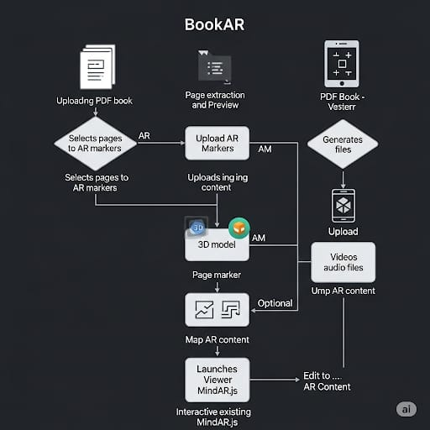
ARCHITECTURE
Dataflow Diagram

Slide 22
Field | Type | Required | Descriptions
Title | String | No | Title of the book (filename if not provided)
pdfFileId | mongoose.Schema.Types.ObjectId | Yes | Reference to the PDF file in GridFS
pageCount | Number | Yes | Number of pages in the PDF
connectedWebpage | String | No | Optional: URL of a connected webpage
Book Database Schema

Slide 23
Field | Type | Required | Description
bookId | mongoose.Schema.Types.ObjectId | Yes | Reference to the Book document
pageNumber | Number | Yes | Page number in the PDF
contentType | String (image, video, audio, model3d) | Yes | Type of AR content
fileId | mongoose.Schema.Types.ObjectId | Yes | Reference to the file in GridFS
filename | String | Yes | Name of the uploaded AR file
uploadedAt | Date (default: Date.now) | No | Timestamp when the AR content was uploaded
ARcontent Database Schema

Slide 24
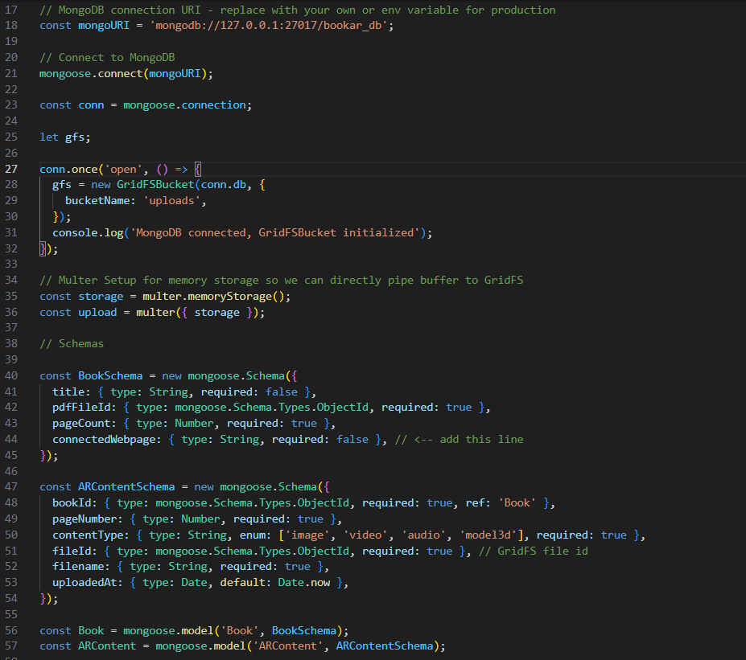
Database Code

Slide 25
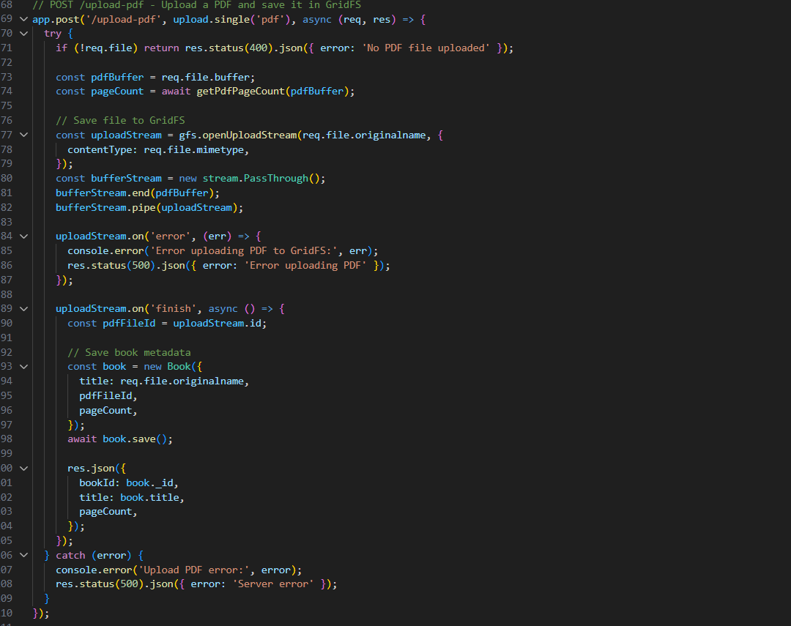
To Save PDF on Server through Gridfs & Book Metadata

Slide 26
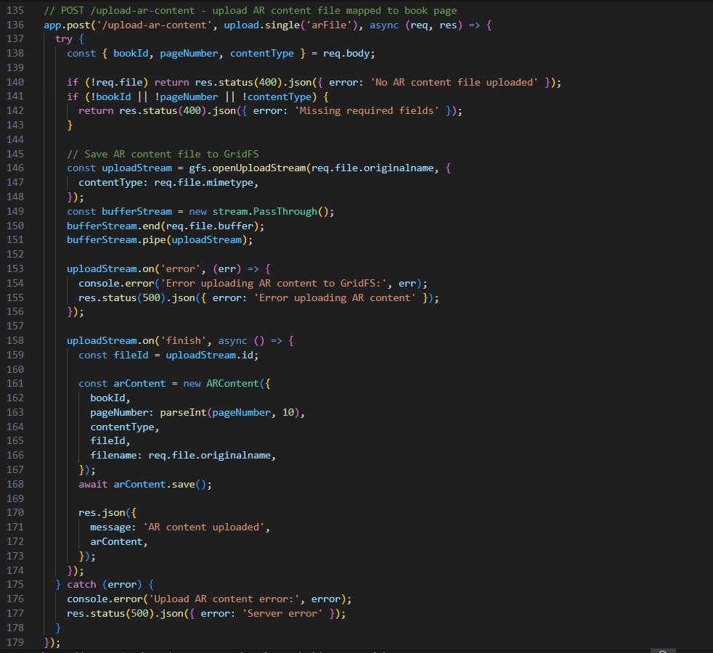
It Map AR content with Book

Slide 27
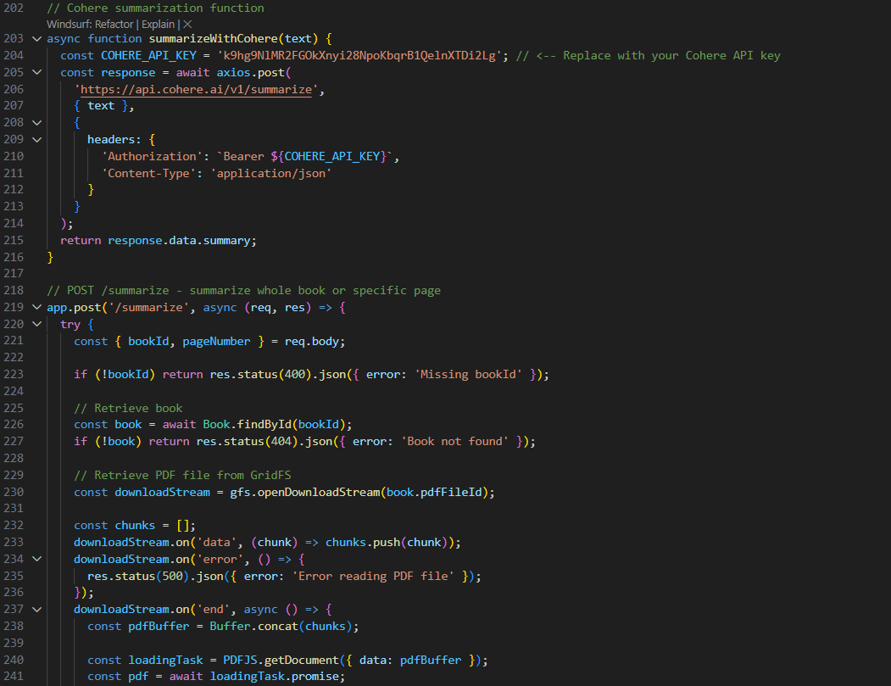
Used for Summarization through Cohere AI API

Slide 28
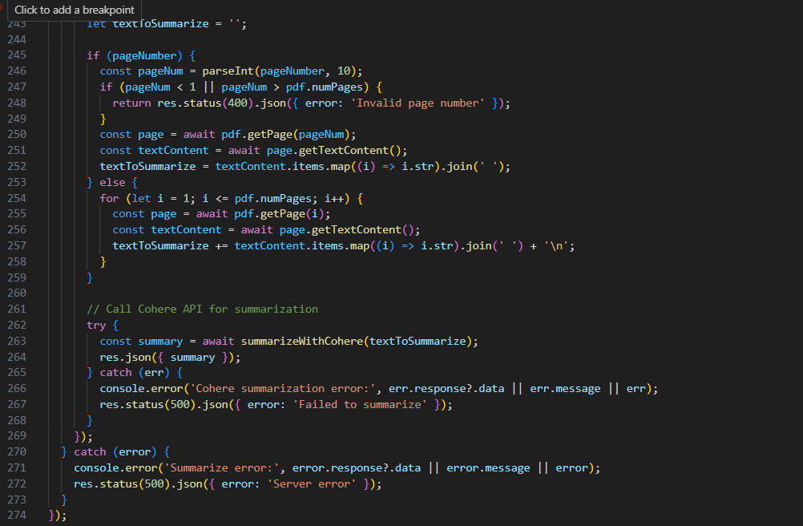

Slide 29
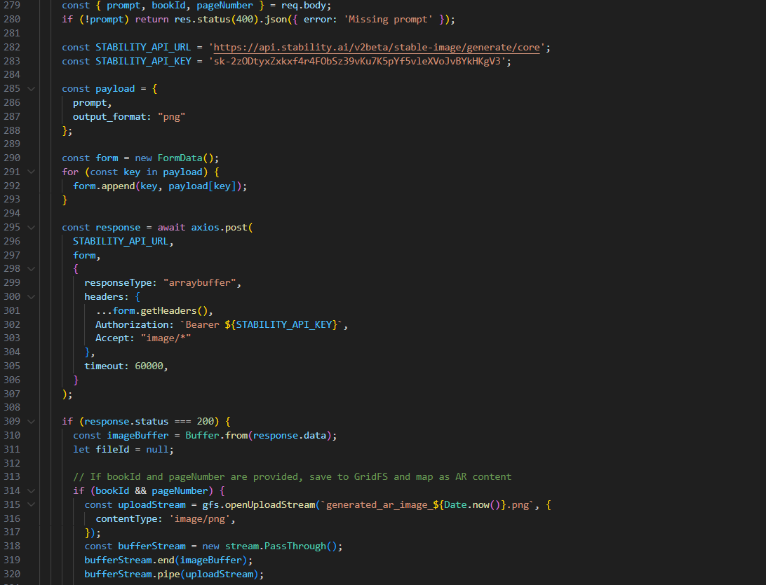
Used for Image Generation to Summarized page through Stability AI

Slide 30
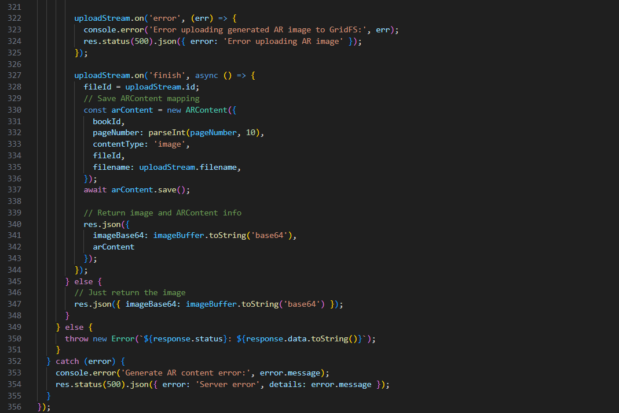

Slide 31
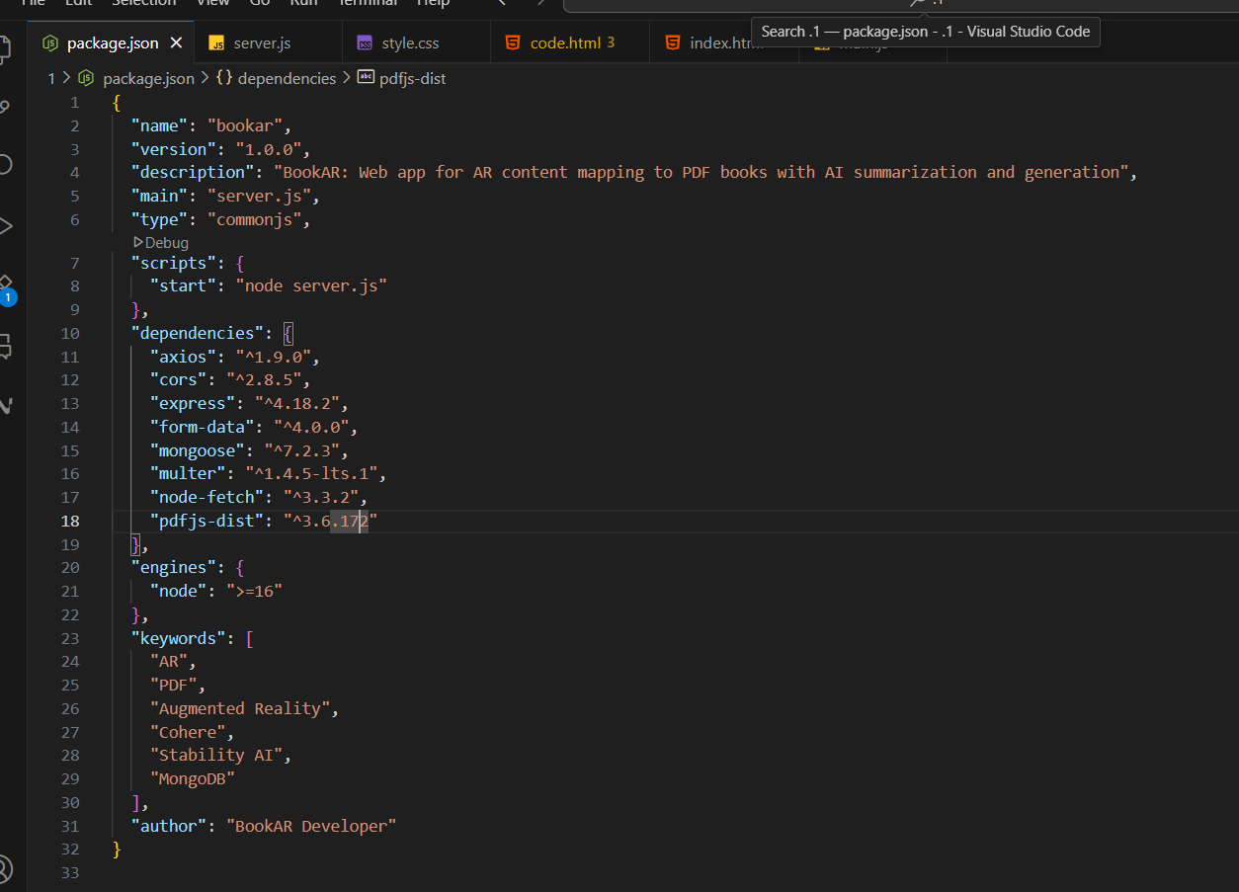
Use for showing Dependencies

Slide 32
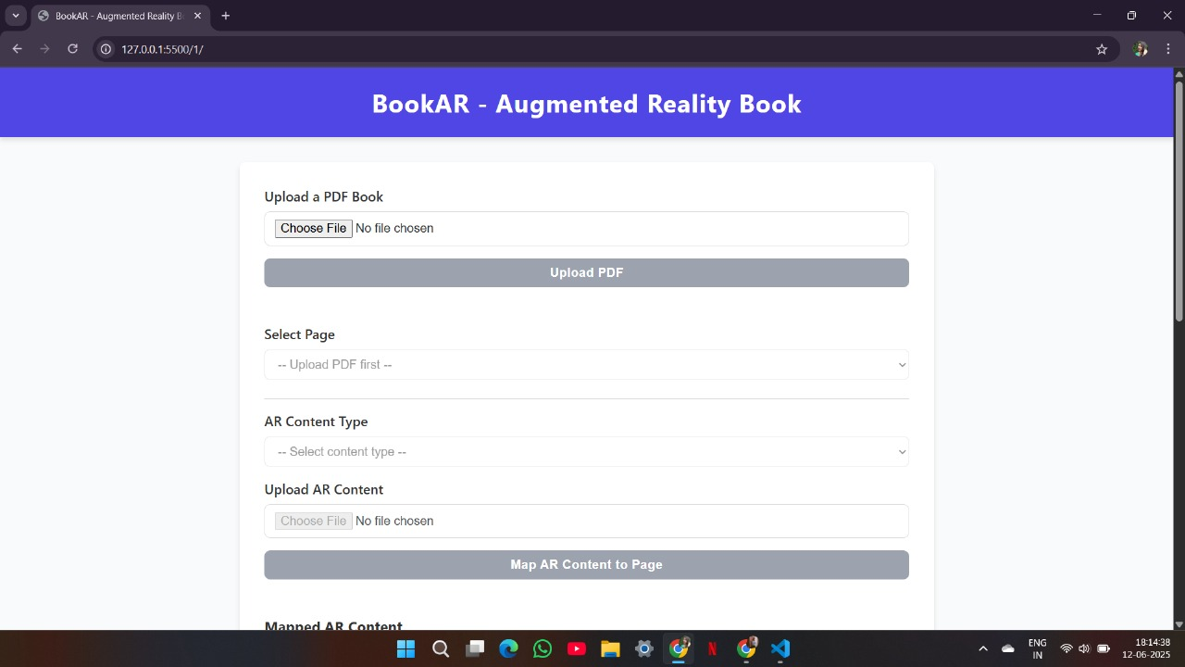
OUTPUT

Slide 33
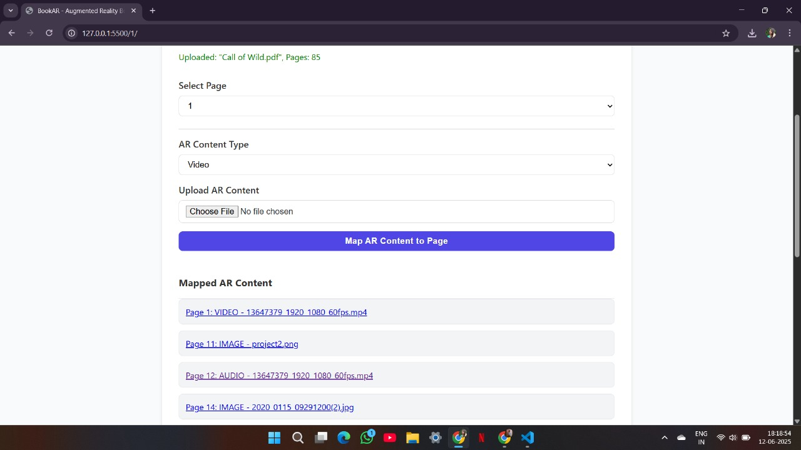

Slide 34
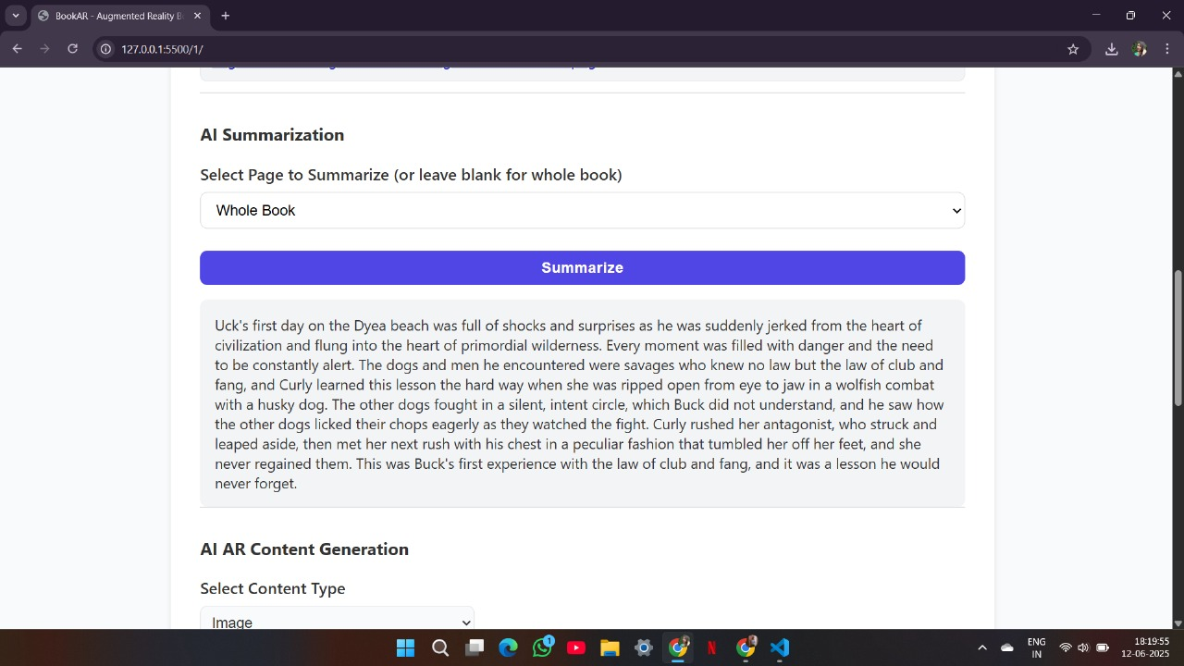

Slide 35
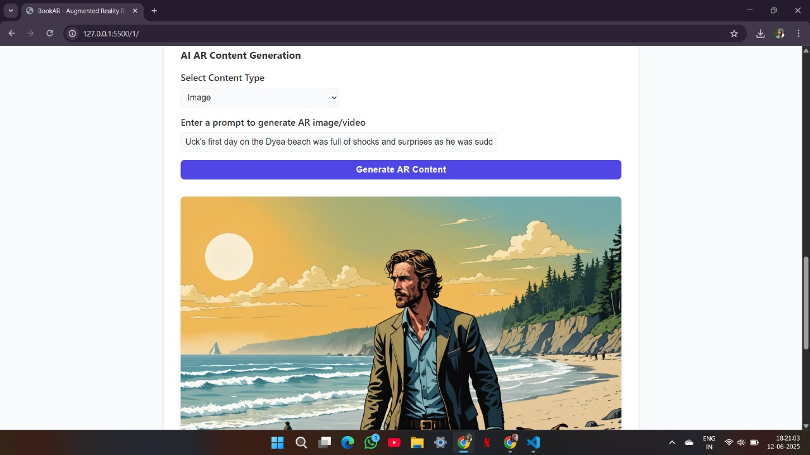

Slide 36
CONCLUSION
BookAR is a full-stack web application that enhances traditional PDF books by mapping interactive AR content (images, videos) to specific pages. It leverages modern web technologies, MongoDB/GridFS for storage, and integrates with AI services like Cohere and Stability AI for summarization and content generation.
The system provides a seamless, immersive reading experience, allowing users to upload, view, and interact with enriched book content through an intuitive web interface. This architecture demonstrates how combining AR and AI can transform static documents into engaging, interactive learning resources.

Slide 37
THANKS !

